Slide 1
Security Policies for Instances and Databases
CIS 483 – Database Security
Computer Information Systems
University of Louisville
Ghiyoung Im, PhD

Slide 2
Learning Objectives
After completing this module, you will be able to:
Design an instance-level security policy
Design a database-level security policy
Design an object-level security policy
Define security monitoring standards for instances and databases

Slide 3
Principals Securables Permissions
Last Week

Slide 4
Principals
Principals request SQL Server resources (e.g., databases, schemas, tables)
Level | Principals
Windows Level | Windows Domain Login Windows Local Login
SQL Server Level | SQL Server Login Server Role
Database Level | Database User Database Role Application Role

Slide 5
Securables
Scope | Securables
Server | Logins Databases
Database | User Role Application role Schemas
Schema | Table View Function Procedure Queue Type Synonym Aggregate

Slide 6
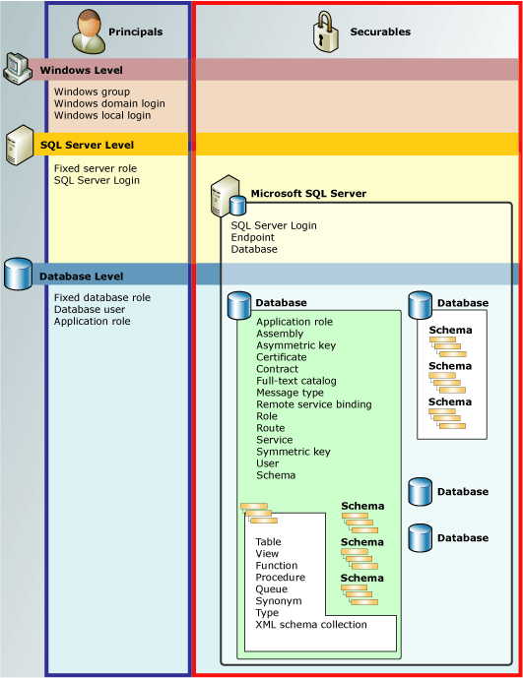
Permissions

Slide 7
User-Schema Separation

Slide 8
User-Schema Separation in 2005
SQL Server 2000
Select * from server.db.owner.object
Example: john.customer => adam.customer (if John leaves the company. Need to change the codes)
SQL Server 2005
Select * from server.db.schema.object
Example: sales.customer (John is the owner of the Sales schema. If John leaves the company, transfer the ownership to Adam)

Slide 9
AdventureWorks Ownership
AdventureWorks
Owner: ghiyoung
Database Users
dbo (default schema=dbo)
TestUser1 (default schema=dbo)
TestUser2 (default schema=dbo)
TestUser3 (default schema=dbo)
Schemas
dbo (schema owner=dbo)
HumanResources (schema owner=dbo)
Person (schema owner=dbo)
Production (schema owner=dbo)
Purchasing (schema owner=dbo)
Sales (schema owner=dbo)

Slide 10
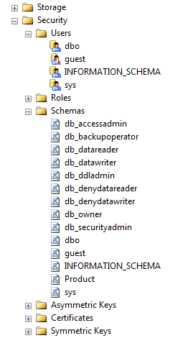
dbo
Database owner - login
Default schema name

Slide 11
User, Database, Schema Creation
Create a new user (TestUserJohn)
Create a new database under the new user login (TestUserJohnDB)
Create a new schema (Sales)
Create a new table (Customer)

Slide 12
TestUserJohnDB Ownership
TestUserJohnDB
Owner: TestUserJohn
Database Users
dbo (default schema=dbo)
Schemas
dbo (schema owner=dbo)
Sales (schema owner=dbo)

Slide 13
Database Ownership
Database ownership
Who owns a database?
=> a login
Who is the dbo user?
=> the database owner, sysadmin
Alternatively, you can assign db_owner role to users to give similar permissions
But, the privileges of the members in db_ownerrole can be denied by the dbo

Slide 14
Schema, Object Ownership
Schema ownership
Ownership of schemas and schema-scoped securables is transferable
The schema owner has full control on all objects in the schema
Schemas can be owned by any database principal, including roles and applications roles
A single principal can own multiple schemas
Multiple database users can share a single default schema
Permissions on schemas and schema-contained securables can be managed with greater precision than in earlier releases
Each user has a default schema from 2005
Object ownership
Permission can be granted on certain objects, not on the entire schema
Notes:
* ALTER AUTHORIZATION (Transact-SQL)
http://msdn.microsoft.com/en-us/library/ms187359.aspx

Slide 15
Guidelines for Determining Authentication Modes and Logon Security Considerations for Designing a Secure Endpoint Strategy Determining the Appropriate Endpoint Authentication Type Guidelines for Securing the SQL Server Agent Service Guidelines for Securing Instance-Level DDL Events Guidelines for Maintaining Updated Hot Fixes or Service Packs Self Test
Designing an Instance-Level Security Policy

Slide 16
Guidelines for Determining Authentication Modes and Logon Security (1/2)
Consider authentication modes to be one of the security options
1. Use Windows authentication
Windows NT LAN Manager (NTLM) or Kerberos authentication used
More secure than SQL Server authentication
Can apply Windows authentication policies (e.g., password length, password complexity, and account locks)
2. Encrypt communications for the logon process
The login via SQL Server authentication is encrypted by default
Can enforce Windows password policy to SQL Server logons

Slide 17
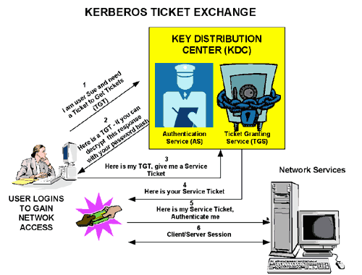
Kerberos Explained
* Source: microsoft.com

Slide 18
Guidelines for Determining Authentication Modes and Logon Security (2/2)
3. Implement password aging
If a password change request in the next logon is made on Windows, the password aging is also enabled on SQL Server
4. Apply the principle of least privilege
Apply this principle when you create a new login to SQL Server

Slide 19
Considerations for Designing a Secure Endpoint Strategy
Create an endpoint: CREATE HTTP ENDPOINT
After the creation of an endpoint, only sysadmin role and the endpoint owner can connect to the endpoint
For other users, GRANT CONNECT ON HTTP ENDPOINT
Apply security checks to objects
Execution of a stored procedure should require connect permissions on the endpoint and execute permissions on the stored procedure
Authenticate all requests
Supported authentication mechanisms on HTTP endpoints: Basic, Digest, NTLM, Kerberos, and Integrated

Slide 20
Determining the Appropriate Endpoint Authentication Type
Basic authentication
Uses base64-encoded id and password
Credentials must map to a valid Windows login
Digest authentication
Uses MD5-hashed
Integrated authentication
Uses NTLM or Kerberos

Slide 21
Creating HTTP endpoints
SELECT * FROM sys.endpoints
CREATE ENDPOINT endpoint_mirroring
STATE = STARTED
AS TCP ( LISTENER_PORT = 7022 )
FOR DATABASE_MIRRORING (
AUTHENTICATION = WINDOWS KERBEROS,
ENCRYPTION = SUPPORTED,
ROLE=ALL);
GO
DROP ENDPOINT endpoint_mirroring

Slide 22
SQL Server Agent
A Windows service that performs scheduled jobs, monitors SQL Server, and fires alerts
Anything related to scheduled, recurring
What kinds of scheduled (automated) jobs do you want to do with SQL Server?

Slide 23
SQL Server Agent
Use msdb
sysadmin access is required
Go to Configuration Manager -> run SQL Server Agent
Need to setup Database Mail first for SQL Agent
a) Enable Database Mail
b) Create the Database Mail profile for SQL Agent
c) Configure SQL Agent to use the profile
d) Restart SQL Server Agent

Slide 24
SQL Server Agent
SQL Server Agent makes you create alerts for the following situations:
Errors, events, performance conditions
There are three types of alerts
SQL Server event alert (SQL Server errors, events)
SQL Server performance condition alert
Windows Management Instrumentation (WMI) event alert

Slide 25
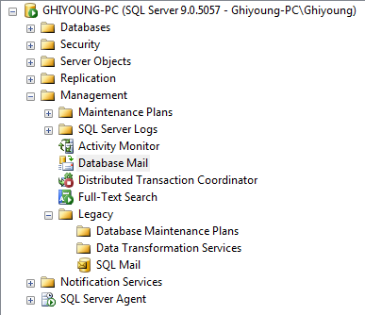
Database Mail Demo
Notes:
# Keep:
- See if database mail is enabled
sp_configure 'database mail’, 0
go
reconfigure with override
config_value: service broker
run_value: database mail (0: disabled; 1:enabled)
--Enabling Service Broker requires exclusive access to database
alter database msdb
set disable_broker
database mail uses Service Broker queue.
select * from sys.databases where name='msdb'
=> Is Broker enabled?
select * from sys.databases where is_broker_enabled=1

Slide 26
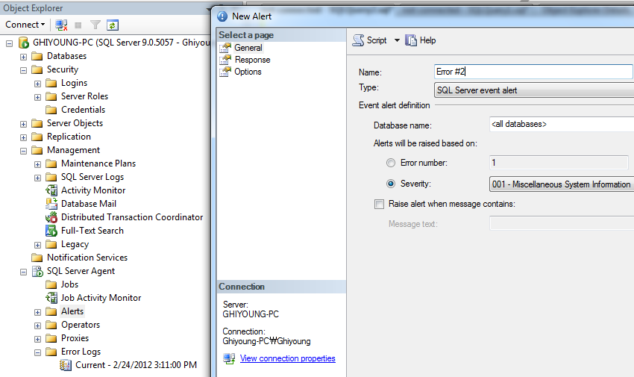
SQL Server Agent – Create Alerts

Slide 27
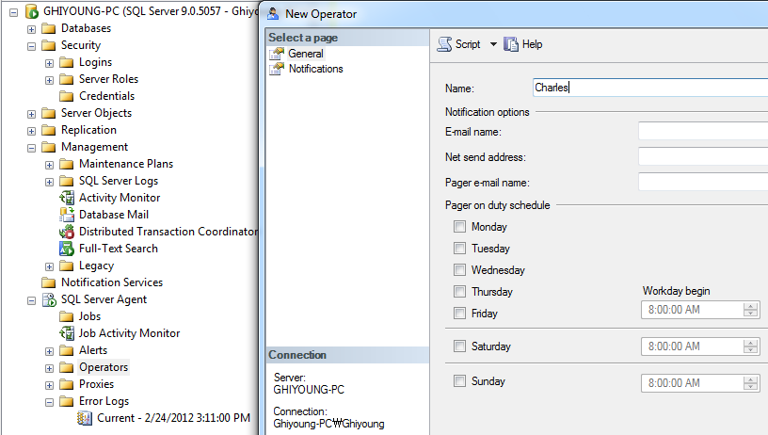
SQL Server Agent – Create Operators

Slide 28
Guidelines for Securing the SQL Server Agent Service
For non-Transact-SQL job step, you must define the security context of the job on Windows
Example: SQL Server Integration Services (SSIS), bulk import running on a Windows account
1. Execute the SQL Server Agent service under a Windows security context
Security (execution) context determined by the principal that is connected to the service
2. Create a local or domain Windows low-privilege account
3. Use subsystems to restrict access
4. Define a proxy account

Slide 29
Guidelines for Securing Instance-Level DDL Events
DDL: Data Definition Language (Create, Alter, Drop)
DDL trigger activated when a DDL event is created
Can be used for rollback operations for security
1. Use DDL triggers to prevent DDL events
Can rollback or cancel the operation
2. Use DDL triggers for auditing
Example:
ALTER_AUTHORIZATION_SERVER
CREATE_DATABASE; ALTER_DATABASE; DROP_DATABASE
CREATE_ENDPOINT; DROP_ENDPOINT; CREATE_LOGIN
ALTER_LOGIN; DROP_LOGIN; GRANT_SERVER
DENY_SERVER; REVOKE_SERVER

Slide 30
DDL Triggers Demo – Database Level
-- Display database log
select * from databaselog order by databaselogid desc
-- Create a table to see a change in the log
create table TestTable1
( colA int )
Go to Database Triggers / enable TRIGGER
create table TestTable2
( colA int )
-- For cleanup
drop table TestTable1
drop table TestTable2
disable TRIGGER

Slide 31
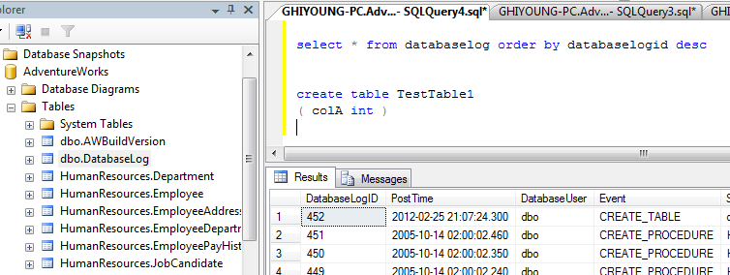
DDL Triggers Demo – Display log

Slide 32
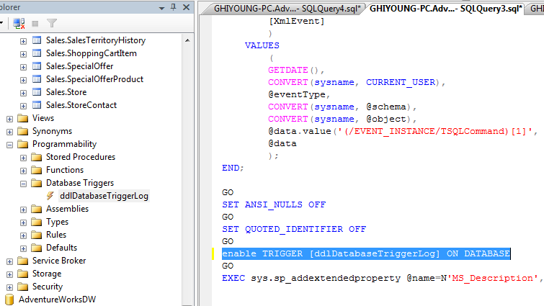
DDL Triggers Demo – enable TRIGGER

Slide 33
How to Maintain Updated Hot Fixes or Service Packs
1. You should understand the changes involved with Hot Fixes or Service Packs
2. You should test the update in a development environment and assess the impact
3. You should test the update in the test environment
4. Notify users of anticipated server downtime after the deployment of the update

Slide 34
Self-Test 1-3

Slide 35
Guidelines for Designing Database Roles Considerations for Designing Database Schemas Guidelines for Designing Database Users’ Privileges Guidelines for Securing Database-Level DDL Events Identifying the Considerations for Database-Level Security Self Test
Designing a Database-Level Security Policy

Slide 36
Guidelines for Designing Database Roles (1/3)
Provides a granular permissions framework
Uses grant, deny, and revoke permission states
SQL Server 2005 provides new permission types
CONTROL, ALTER, ALTER ANY, IMPERSONATE, and TAKE OWNERSHIP
VIEW DEFINITION
Grant permission to view metadata even without other permissions on the object
However, the user needs permissions (e.g., SELECT, CONTROL) to read data from the table

Slide 37
Guidelines for Designing Database Roles (2/3)
2005 supports fixed database roles, and user-defined database, application roles
Fixed database roles
Exist at the database level
Applicable in all databases and used to commonly used permissions quickly
Example: db_datareader and db_datawriter
User-defined database roles
Group users with the same security privileges within the database
Can assign Windows user or group accounts to user database roles
Can assign a SQL account or a Windows account to database user roles

Slide 38
Guidelines for Designing Database Roles (3/3)
Application roles
Do not contain members; inactive by default
Activated by a built-in stored procedure: sp_setapprole
Active until the connection ends
The application role credentials passed to the database in clear text format: need to secure the network by using IPsec or SSL
Application roles can use EXECUTE AS to connect to other databases
Can access other databases through the guest user account in those databases
The user assumes the application role permissions, losing its own permissions

Slide 39
Considerations for Designing Database Schemas
Schema
Container of objects
In 2000, objects owned by a user
1. Object qualification
2000:
SQL Server objects: server name, database name, object owner, and object name. For example, For example, in SQL Server 2000, a table named Products that is created by user A in the Sales database, in an instance named Server1, would have Server1.Sales.A.Products (Server1=instance; Sales=database; A=user; Products=table)
2005
SQL Server Objects: Server1.Sales.Stores.Products (Stores=schema)

Slide 40
Considerations for Designing Database Schemas
2. Permissions
Schemas are database-level securables
Applicable permissions:
TAKE OWNERSHIP; ALTER; EXECUTE; INSERT; DELETE; UPDATE; SELECT; REFERENCES; VIEW DEFINITION
SELECT permissions to a schema => allows SELECT to the objects within the schema
The most restrictive permission takes precedence
Example: A schema has three tables. SELECT permission granted on the schema. Table 1 has explicit DENY on it.
Table 2 & Table 3
=> Can access
Table 1
=> Can’t access

Slide 41
Considerations for Designing Database Schemas
3. Multiple ownership
Owner of a schema: must be a database-level principal
Schema can be owned by a role
Multiple users can have ownership permission
Can add or remove database users without changing the ownership
4. Grouping objects and ownership chains
Schemas used to group objects based on the nature of the objects.
Example: Person schema in AdventureWorks has Address, AddressType, Contact, ContactType, Countryregion, StateProvince tables

Slide 42
Guidelines for Designing Database Users’ Privileges
Apply the principle of least privilege
Use schemas to grant permissions
Remove users when access to a database is not required. Don’t add users again to the database once removed
If possible, utilize the predefined database roles
Monitor memberships to highly privileged groups closely (e.g., users in db_owner role)
Define a default schema for users. A user can be the owner of schemas, and needs a schema for the work environment

Slide 43
Guidelines for Securing Database-Level DDL Events
DDL triggers at the database level
Manage modification, creation, or deletion of objects inside a database
1. Use DDL triggers
Use to audit database and instance related events
Use EVENTDATA function to get information about server or database events
2. Audit DDL events with SQL Trace or Profiler
Use Objects event classes to trace who modified, what object modified, and when object modified (3 events: Object:Altered, Object:Created, and Object:Deleted event classes)

Slide 44
Guidelines for Securing Database-Level DDL Events
DDL triggers at the database level
Manage modification, creation, or deletion of objects inside a database
1. Use DDL triggers
Use to audit database and instance related events
Use EVENTDATA function to get information about server or database events
2. Audit DDL events with SQL Trace or Profiler
Use Objects event classes to trace who modified, what object modified, and when object modified
Object:Altered, Object:Created, and Object:Deleted event classes

Slide 45
Identifying the Considerations for Database-Level Security
Answer the following with True or False:
Use TAKE OWNERSHIP to change ownership of an object
Fixed database roles are defined at the DATABASE level
Application roles are ACTIVE by default
The user who created the object IS the default owner of the object
The LEAST restrictive permission takes precedence
Application roles contain NO members
Object grouping AFFECTS ownership chaining
You CAN audit users within an application role
Database WITH a guest user account are inaccessible to applications roles
Notes:
# Keep
use TAKE OWNERSHIP to change ownership of an object (F) / ALTER AUTHORIZATION (T)
fixed database roles are defined at the DATABASE level (T)
application roles are ACTIVE by default (F)
the user who created the object IS the default owner of the object (F)
the LEAST restrictive permission takes precedence (F)
application roles contain NO members (T)
object grouping AFFECTS ownership chaining (F)
you CAN audit users within an application role (F)
database WITH a guest user account are inaccessible to applications roles (F)

Slide 46
Self-Test 4-7

Slide 47
Guidelines for Designing a Permissions and Data Access Strategy Considerations for Designing the Execution Context Considerations for Securing Module Execution Guidelines for Designing a Security Policy for CLR Objects Identifying Code Access Permission Sets Self Test
Designing an Object-Level Security Policy

Slide 48
Guidelines for Identifying What to Monitor Guidelines for Determining the Classification System for Alerts Guidelines for Determining the Notification Policy Determining the Classification System and Notification Policy Self Test
Defining Security Monitoring Standards for Instances and Databases

Slide 49
Scenario Exercise: Designing an Instance-Level Security Policy Exercise: Designing a Database-Level Security Policy Exercise: Designing an Object-Level Security Policy Lab Review
Lab A: Designing Security Policies for Instances and Databases

